Slide 1

Searching for Minds, Empirically:
Introduction to Neuroscience of Consciousness
HSSP 2020 class S14132
Week 2 07.18.2020

Slide 2
Today’s Agenda
Review: What is consciousness?
Mind-Brain Relationship and Problem
How do we search for consciousness empirically?
Neural Correlate of Consciousness (NCC)
Next class preview
Extra materials

Slide 3
Course overview & objectives
Our main question is: how do we empirically search for consciousness?
1. What is consciousness? How do we define and search for it in the physical world?
2. What happens when consciousness is not there? + Methods of measure
3. Can you be conscious.. but also unconscious? + Methods of measure
4. Can consciousness arise from stuff that is not brain-matter (i.e. neurons)?
5. Can the "self", our subjective experience, be measured with neuroscience?

Slide 4

Remember our intention!
What things are conscious and what things aren’t conscious? What is the reasoning behind the distinction? What is our criteria to attribute consciousness to something?
→ Need for a systematic model of what the mind and consciousness is, including their definition, their nature and their requisite conditions.

Slide 5
Consciousness!

Slide 6
What is consciousness?
Contexts in which we use the term “conscious”:
Sleep vs Awake/Alert
Aware vs. Unaware
Unconsciously doing something (i.e. without thinking)
A conscious person …
has an awareness of themselves, the events happening around them, and the ability to process them.
is awake, as opposed to asleep or in a coma

Slide 7
Consciousness!
Why think robots aren’t “conscious” in the way that we are? What's the difference between them and us?
What do we mean when we say something is conscious? What are we saying that they are capable of doing?

Slide 8
Consciousness!
Consciousness is the subjective, or phenomenal, aspect of your first-person experience.
This seems to be the essential property we look for when determining whether something is conscious.
Notes:
Generally two lines of research in generic consciousness:
Generic consciousness is an all-or-nothing characteristic that an organism can have. This is what we want to evaluate in order to decide how to treat the organism. But this can also be applied to individual mental states.
The question regarding generic consciousness is, what conditions of the nervous system are necessary to make a mental state conscious?

Slide 9
Phenomenal vs. Access Consciousness
Phenomenal Consciousness
Access Consciousness
You have a subjective experience that correspond to what it is like for you to have the experience.
What it feels like to see color, feel pain, think and believe.
You have access to the information coming from the experience to utilize in various cognitive functions.
Access without subjective experience: Blindsight, Philosopher’s Zombie
Notes:
The linked song is rather painful to listen, but the lyrics are fun and it’s performed by a famous philosopher at a consciousness conference.

Slide 10

Phenomenal vs. Access Consciousness
Notes:
Here is a brief video of the man who experiences complete blindness because his visual cortex in both hemispheres has been damaged. The researchers (including Dr. Weiskrantz, mentioned above) set up an obstacle course for the man (whose face is blurred to protect his privacy). Watch how well he moves through the objects without help. The man behind him is just there as a safety precaution.

Slide 11
Phenomenal vs. Access Consciousness
wakeful state vs. (dreamless) sleep --- consciously aware vs. unconscious thinking
Notes:
The common difference between these two states = phenomenal consciousness!

Slide 12
The empirical question
What conditions are necessary to have this—to make a mental state conscious?

Slide 13
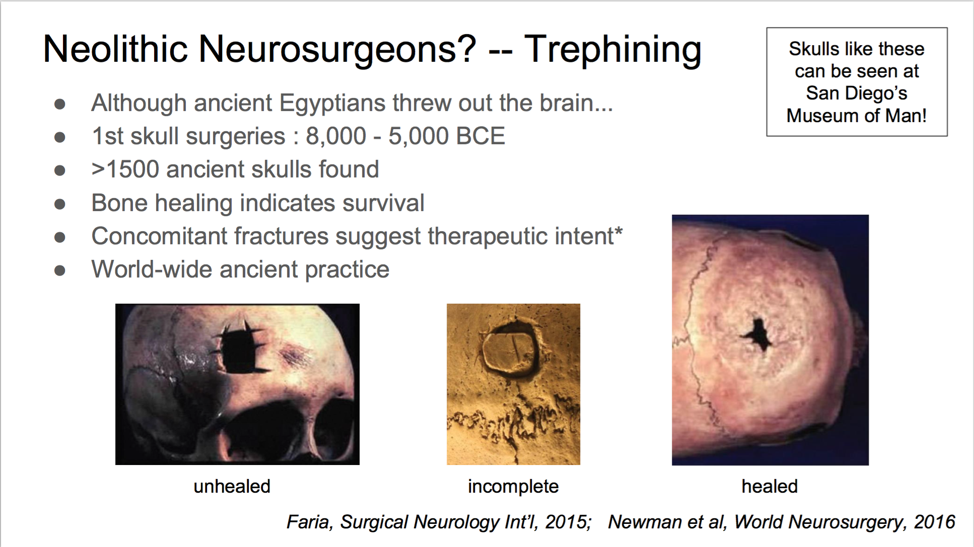
What is needed for consciousness?
The first prerequisite for the existence of consciousness in a being: the existence of a mind!
perhaps some neural property. (Because we think mind is in the brain)
→ What does it mean for the mind to reside in the brain (body)?
Notes:
So I guess the main question to ask in finding consciousness empirically, is to question, Where is the mind? I assume that we all agree to some level that it is in the brain somewhere, maybe, or at least that the brain affects it somehow, because I named the title of this course “Neuroscience of consciousness” and you all bought into it and came here. Apparently our ancestors way back in 8000BCE had that suspicion too, that the mind resides in the brain/head.
What does it mean for the mind to reside/be located in the brain?

Slide 14
Mind, body, and mind-body relationship
What are some properties or characteristics of the mind?
What are some properties or characteristics of the body?
What are some activities you do with each of them?
What are some examples of the mind and body interacting/influencing one another?
See our group’s ideas here!
Notes:
https://padlet.com/youngzielee/rvtsryz8hgn1cv2m

Slide 15
Mind, body, and mind-body relationship
Mind
Body
Mind-Body Interaction Examples
Thoughts, Memories
Emotions, Feelings
Beliefs, Intentions
Sensations (touch, sight, smell, etc.)
immaterial, non-physical, unobservable (private)
Movement
Automatic physiological functions (heartbeat, breathing)
Height, weight, texture, etc.
→ physical, observable (public)
Intention to get ice cream → go to fridge and get ice cream
Touch hot pan → feel pain
Body carries out mind’s ideas
Mind works with input from the body
→ How is the mind and body unified or tied to each other? (mind-body problem)

Slide 16
The mind-body problem
What is the relationship between the mind and body/brain?
If the mind exists in the body somewhere (or is at least tied to a body in some way), how is that happening?
More specifically, How are they tied to each other? How do they interact?
→ It is hard to see how because mind and body seem to be quite distinct.

Slide 17
The problem in the mind-body problem
Mind-body interaction is taken for granted, but:
How is it possible that something non-physical (mind stuff) leads to (causes) something physical (bodily stuff)?
There is no obvious means by which the two entities are connected and are interacting through.
Any effect must have a causally relevant or causally efficacious property.
Notes:
Let’s look at these one by one…

Slide 18
The problem in the mind-body problem
1. How is it possible that something non-physical (mind stuff) leads to, or causes, something physical (bodily stuff)?
(premise) Any physical effect has a “complete” physical cause
  i.e. you shouldn’t need to appeal to anything non-physical to fully account for anything that happens in the physical universe.
→ Physical effects of the body should be fully accounted for by physical causes; then where does the mental fit in?

Slide 19
The problem in the mind-body problem
2. There is no obvious means by which the two entities are connected and are interacting through.
Any causal relation must have an interface by which the cause and effect are connected (e.g. physical contact).
→ If contact is not what connects the mind and body, what is?

Slide 20
The problem in the mind-body problem
3. What if we say mind = brain (body)?
In any physical cause-effect relationship, the cause’s relevant properties cause the properties of the effect. (“causally relevant/efficacious”)
  E.g. impression of a cube on clay, high-frequency sound shattering glass
The brain’s mental/immaterial properties like beliefs and intentions (rather than just its physical properties) are causally relevant in the physical effects.
Therefore mental properties should be considered as part of the account of physical effect. (therefore mind-body problem persists.)

Slide 21
Issues related to the mind-body problem
How does having an intention cause our changes in the body?
How does this mind and this body relate to our sense of self and identity?
What does it mean for a particular mind to belong to a particular body? How does that body bind that mind?
Free will and moral responsibility
And …

Slide 22
Consciousness!
What do we mean when we say something is conscious? What are we saying that they are capable of doing?
Why think robots aren’t “conscious” in the way that we are? What's the difference between them and us?
→ It seems that we require the presence of the mental properties of feeling pain or having intentions that cause physical behavior.

Slide 23
Phenomenal vs. Access Consciousness
The Philosopher’s Zombie
: Exactly like us, but no qualia.
A being could function like us without the subjective experience.
Notes:
Descartes’ thought that non-human animals are like zombies and that their behavior is wholly explicable with physical mechanics of their body.

Slide 24
The Hard Problem of Consciousness
How does physical stimulation of the senses give rise to subjective experience, or qualia?
Why is it that some physical processing of physical stimuli gives rise to a rich inner life?
Why is it there for us? How is it there?
Who has it there?
The Hard Problem of Consciousness is a specific issue of the mind-body problem.

Slide 25
How do we find consciousness, empirically?

Slide 26
The Scientific Approach
The goal of a scientific/empirical investigation is to construct an explanation of a phenomenon
Should be based on observable data
Can this method be applied to the problem of consciousness?
The challenge: (phenomenal) consciousness is an inherently subjective and private (as opposed to publicly observable) mental phenomenon.
→ We use observations of behavior and brain activity, which are (indirect) windows to conscious state.
Notes:
This is an assumption!!

Slide 27
The Scientific Approach: NCC
When does consciousness occur—with what neural properties?
→ Identify neural states that turn consciousness on and off
: Search for the Neural Correlate of Consciousness (NCC): the minimal neural condition that is causally necessary for (or is identical to) a conscious state

Slide 28
The Scientific Approach: NCC
Search for the Neural Correlate of Consciousness (NCC): the minimal neural condition that is causally necessary for (or is identical to) a conscious state
  There is a NCC for every conscious percept.
  What is happening in the brain when there is consciousness?
  What is happening in the brain when there isn’t consciousness?
Finding the NCC does not necessarily explain why or how. (Correlation, NOT Causation!)

Slide 29
The Scientific Approach: NCC
Finding the NCC does not solve the Hard Problem of consciousness!
Rather, scientists are tackling the more general question of when, under what neural conditions, does consciousness occur.
But need to start with finding correlates to begin with.
Notes:
Didn’t quite get to this.

Slide 30
The Scientific Approach: NCC
Task after finding the NCC:
Is the correlated neural state is necessary or sufficient for consciousness?
→ manipulate the system of testing and observe what happens.
Testing for necessity of a condition: eliminate or disrupt the NCC and see if consciousness is gone.
Testing for sufficiency of a condition: produce or modulate the NCC and see if consciousness is there.
Notes:
Got to this

Slide 31
The Scientific Approach
In the empirical investigation of consciousness, we need to leverage the observable behavior that serve as indirect windows to one’s conscious mental state.
The most telling window for the state of consciousness are cases that clearly separates state of unconsciousness and consciousness (e.g. sleep vs. awake, coma vs. awake, consciously aware vs. subconscious processing)
Notes:
Didn’t quite get to this, mention in email

Slide 32
Preview: What happens when consciousness is not there?
What is the difference in the brain when we are conscious vs. unconscious?
Observe behavior with clear contrast in existence or absence of consciousness
  Sleep vs. Awake/Coma vs. Awake (global approach)
  Aware vs. Unaware (content-specific approach)
Notes:
Starting here next time!
Some of the behaviors that scientists have decided to look into, in particular, i.e. chosen as an effective/most showing/transparent (?) window on consciousness are those states that seem to clearly display an absence of consciousness compared to normal everyday conscious states: e.g. Sleep vs. awake, coma vs. awake, aware vs. unaware (conscious vs. subconscious processing)

Slide 33
Preview: What happens when consciousness is not there?
What is the difference in the brain when we are conscious vs. unconscious?
What can we learn from it?
What can’t we learn from it?
+ methods of measuring brain activity (fMRI, EEG) (recording, correlational)
+ methods of manipulating brain activity (TMS) (perturbational, but often not isolated)
+ methods of investigating lesions (causal, but often not isolated)
Notes:
For stimulation studies: immediate effects provide strong evidence for a given structure being causally
involved; may induce large networks recruitment (with typically effects that are less site-specific) in some cases

Slide 34
Extra readings & materials
Tim Crane Introduction to Mind-Body Problem
Thomas Nagel, What is it like to be a bat?

Slide 35
Any questions?

